Slide 1
Phishing Website Detection using GRU and Stacked GRU
Project title

Slide 2
Team Members
20BLC1075 - KSHITIJA SRIVASTAVA
20BEC1352 – SANTHANABHARATHI
20BEC1342 – KAMALESH

Slide 3
Abstract
Due to the exponential growth of internet users, phishing has recently become more dangerous. The phishing attack of today puts both people's daily lives and the internet world in grave danger. In these assaults, the attacker poses as a trustworthy party with the purpose to steal. sensitive information or the user's digital identity, such as credit card numbers, login credentials for accounts, and other individual attributes. A phishing website, also known as a falsified website, is one that is created to trick a user into giving up their personal information in return for something valuable, such their login credentials. In order to detect the websites that are fake, this study will introduce machine learning and deep learning approaches and then apply all these algorithms to our dataset. The optimum technique for phishing website detection is then chosen, one that has the highest degree of precision and accuracy.

Slide 4
Contribution of the project
Improved accuracy: The project contributes to improving the accuracy of phishing website detection. Phishing attacks are becoming more sophisticated and harder to detect, and traditional methods of detection may not be sufficient. The use of GRU models can help improve the accuracy of detection by capturing more complex temporal dependencies in the data.
Better understanding of website features: The project involves feature engineering techniques that convert website URLs into numerical features that can be used to train the model. This helps to better understand the characteristics of phishing websites and legitimate websites and can be used to identify key features that are important for detection.
Application of deep learning techniques: The project applies deep learning techniques to the task of phishing website detection, which is a relatively new and emerging field. This helps to expand the use of deep learning beyond traditional applications such as computer vision and natural language processing, and shows that it can be successfully applied to cybersecurity tasks as well.
Contribution to cybersecurity: The project has the potential to contribute to improving cybersecurity by helping to prevent users from falling victim to phishing attacks. Phishing attacks can result in significant financial loss and data breaches, and improving the accuracy of detection can help reduce these risks.

Slide 5
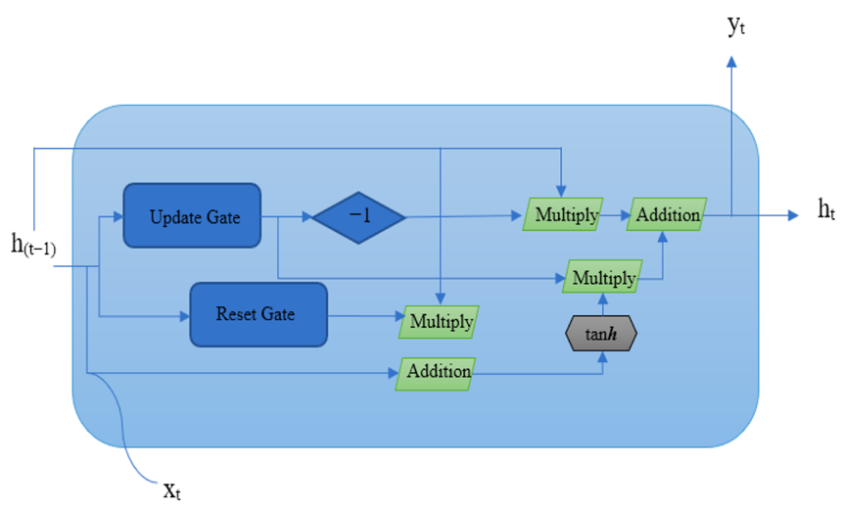
Proposed work
The proposed work is to train a stacked GRU model for phishing website detection. The model takes as input a sequence of website features and outputs a binary classification indicating whether the website is legitimate or phishing.
To use this model for phishing website detection, you would first need to gather a dataset of websites with their corresponding labels (legitimate or phishing). You would then need to preprocess the website data into a sequence of features that can be fed into the GRU layers.
Once you have your preprocessed dataset, you can use the code above to define and train the stacked GRU model. During training, the model will learn to recognize patterns in the website features that are indicative of phishing.
After training, you can use the model to predict whether a new website is legitimate or phishing by feeding it the website's features and obtaining a binary output. The model can be used in a variety of applications, such as web browser extensions, email filters, or network security tools, to help protect users from phishing attacks.

Slide 6
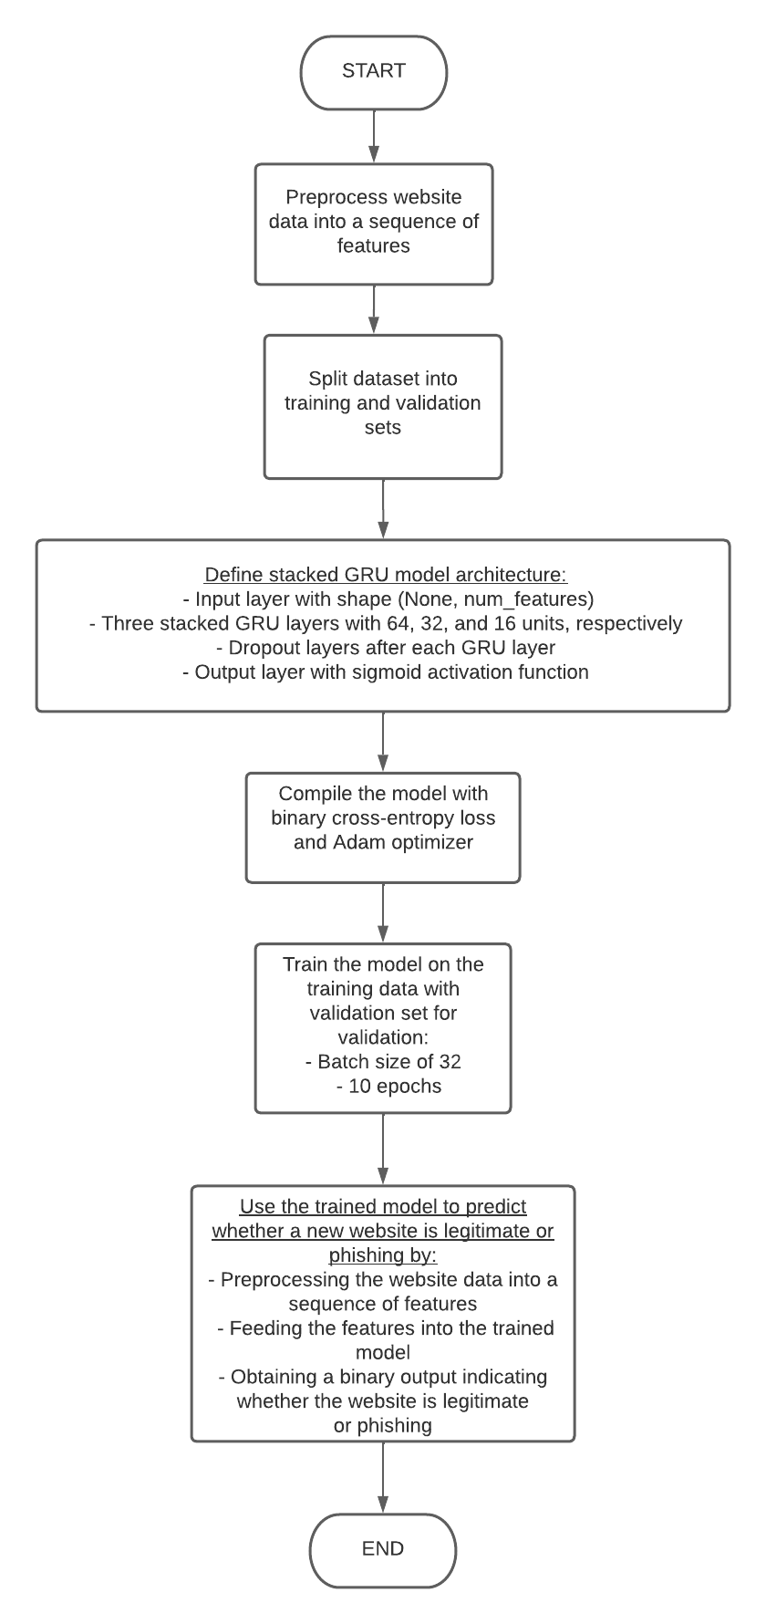
Flow chart

Slide 7
Comparative study With LSTM model
In general, LSTM (Long Short-Term Memory) is another type of recurrent neural network that is often used for sequence classification tasks such as phishing website detection. Compared to GRU, LSTM has more complex memory cells that can capture longer-term dependencies in the input sequence. A comparative study between stacked GRU and LSTM for phishing website detection can be conducted using the same dataset and evaluation metrics. The performance of the two models can be compared in terms of accuracy, precision, recall, F1 score, and AUC.
In some cases, LSTM may outperform GRU due to its ability to handle longer-term dependencies. However, in other cases, GRU may be more suitable for the task of phishing website detection due to its simpler structure and faster training time.Ultimately, the choice between GRU and LSTM depends on the specific characteristics of the dataset and the performance requirements of the application. It is often recommended to try both models and compare their performance to determine which one works best for a given task.

Slide 8
Conclusion
Phishing attacks are a constant threat to individuals, government organizations, and industries, where attackers create fake websites that appear legitimate in order to steal personal information. To combat this, this paper presents the use of deep learning techniques, specifically Long Short-term Memory (LSTM ) for detecting phishing URLs. The proposed models were evaluated using publicly available datasets and various performance metrics. The results of the experiments indicate that the Bi-LSTM model performed the best among the three models in all evaluation measures. In the future, we would like to use other deep learning algorithms to detect phishing websites using massive, imbalanced datasets.

Slide 9
Future works
Transfer learning techniques can be applied to improve the performance of the models by leveraging pre-trained models on large datasets such as ImageNet. The addition of attention mechanisms to GRU and stacked GRU models can improve the interpretability of the models by highlighting the important features and sequences that contribute to the classification decision. Ensemble methods such as bagging, boosting, and stacking can be used to combine multiple models and improve the overall performance and robustness of the system.The models can be adapted to the dynamic nature of the web by incorporating online learning techniques that enable the system to continuously update and improve its performance based on new data. Multi-modal data integration: The models can be enhanced by integrating multiple sources of data such as text, images, and network information to capture a more comprehensive representation of the website and its context. The models can be optimized for real-time deployment by reducing the computational complexity and improving the inference speed using techniques such as quantization, pruning, and compression

